Slide 1
MongoDB
Faraz Khan & Hamza Shahid

Slide 2

What is it?
NoSQL database
  Document oriented
JSON syntax
3 key features
  Fault tolerance
    Avoid redundant copies
  Scalability
    Seamless scaling
  Data near users
    Move data wherever needed
Notes:
Each database gets its own set of files on the file system. A single MongoDB server typically has multiple databases.
Documents within a collection can have different fields.
3 key features
Fault tolerance
Keeping redundant copies on different servers
Scalability
Seamlessly scales across multiple servers
As data grows, just add more servers
Data Near Users
Move data to where you need it for faster access

Slide 3


Slide 4

Relational
Tabular
Flat
Inflexible
Map everything out
Figure out exact scheme
Notes:
Relational
inflexible
figure out exact schema
what tables, fields you use ahead of time

Slide 5

Non-Relational
Non-tabular
Flexible
Add fields as you go
Change data schema without modifying existing data
Uses internal memory for storing working set hence enabling faster access of data
Notes:
Non-Relational
Uses internal memory for storing the (windowed) working set, enabling faster access of data.

Slide 6
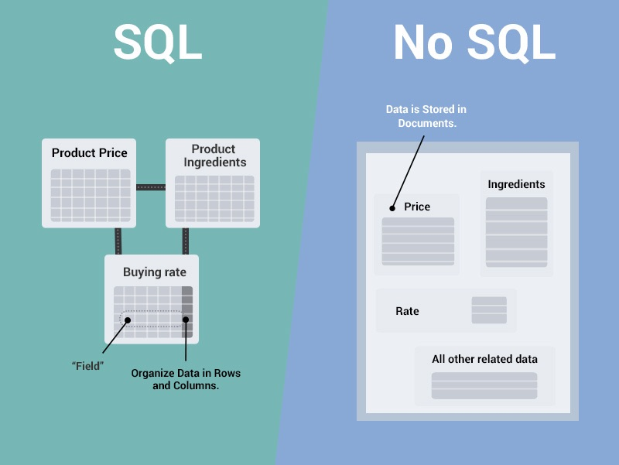

Slide 7
Demo

